Slide 1
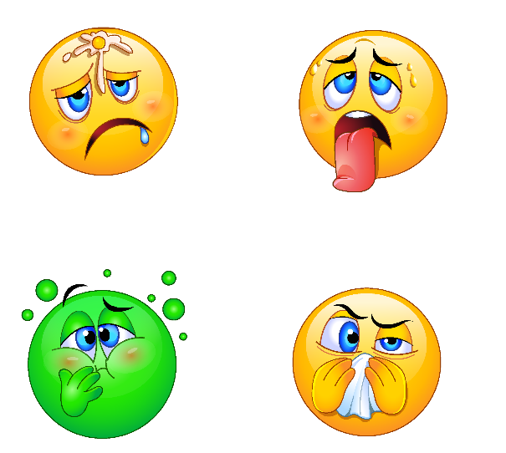
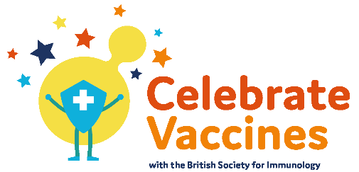
Going viral
Your name
Follow us @britsocimm @[your_handle] #CelebrateVaccines
Learn more www.immunology.org [Insert your web link here]

Slide 2
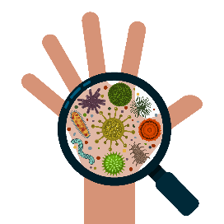
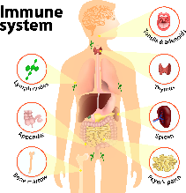
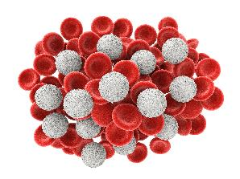
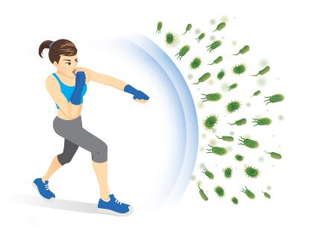
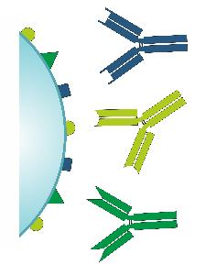
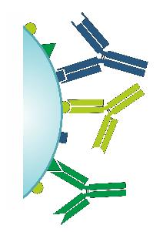
immune system
pathogens
viruses, bacteria, parasites
white blood cells
antigens
antibodies
immunity

Slide 3
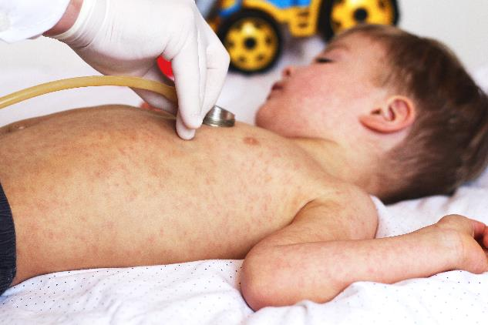
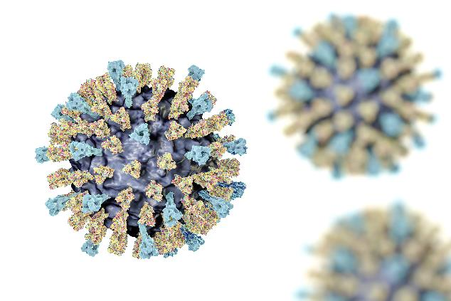
Measles
a highly contagious infectious disease caused by the measles virus

Slide 4
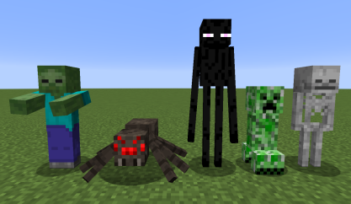
Notes:
https://account.mojang.com/terms

Slide 5
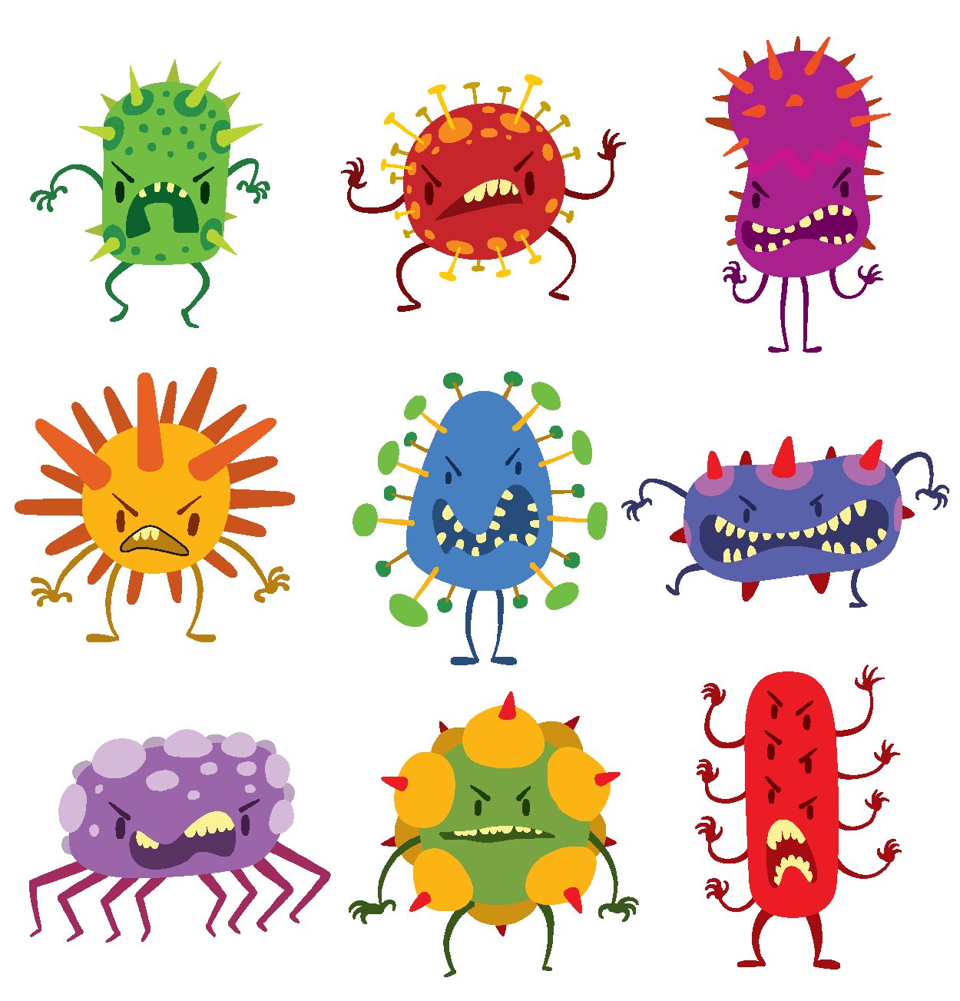
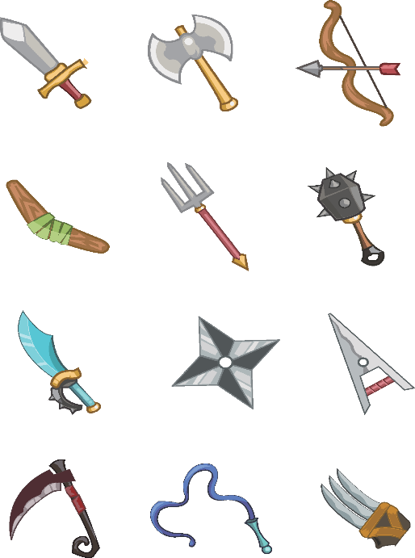
?

Slide 6
Discuss
What happened once the white blood cells discovered the right antibody for the virus?
What happened when the body was infected with a virus it had before? Why?

Slide 7
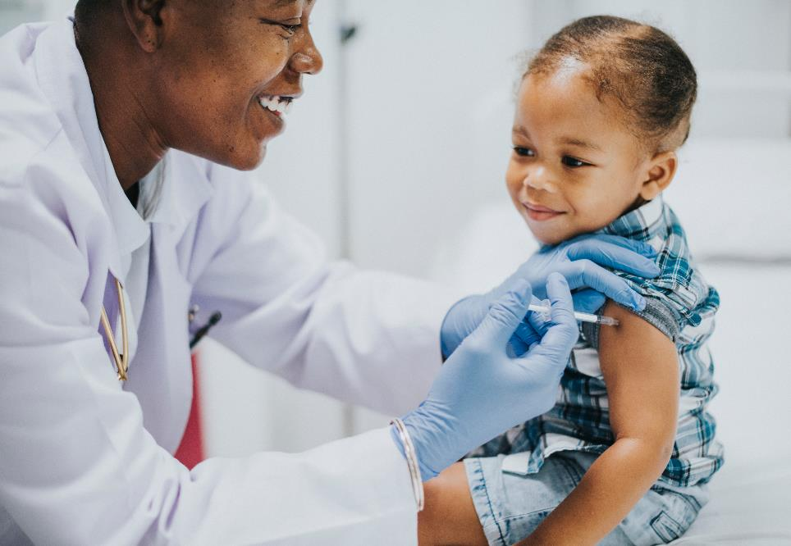

Slide 8
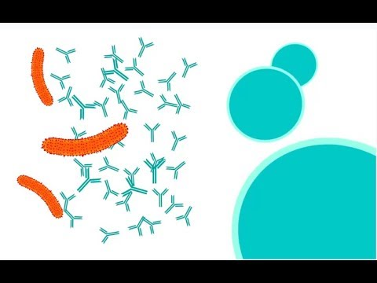
How do vaccines work?

Slide 9
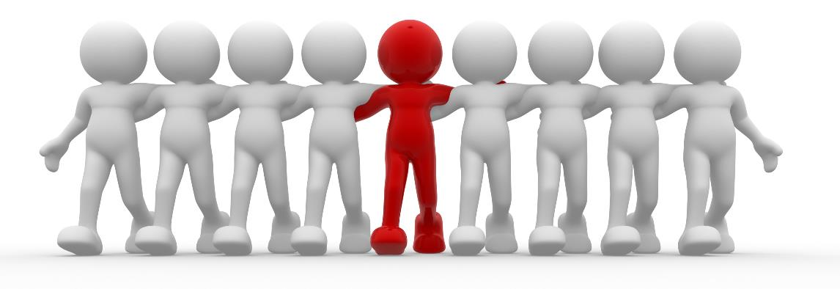
Heard of herd immunity?

Slide 10
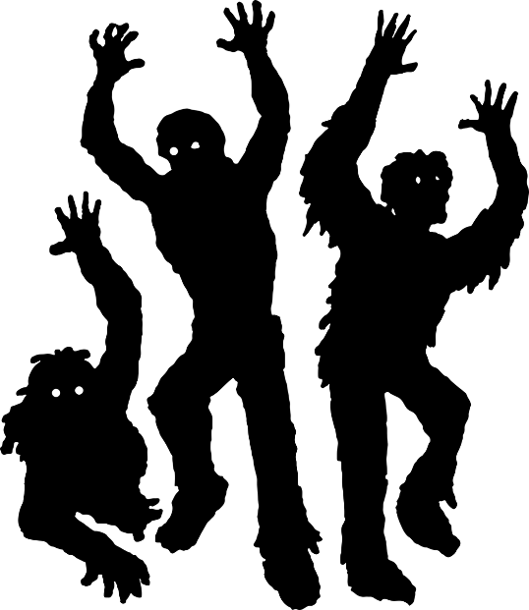
Preventing a zombie apocalypse…

Slide 16
Quiz!
What type of germ does a vaccine protect you against?
Most vaccines protect us from viral infections (viruses), some protect us from bacterial infections
What part of a virus particle prompts an immune response (makes you feel ill)?
Antigens
What does a vaccine contain?
Dead or weakened virus particles
What does your body produce to fight viruses?
Antibodies
What part of your immune system produces antibodies?
White blood cells

