Slide 1
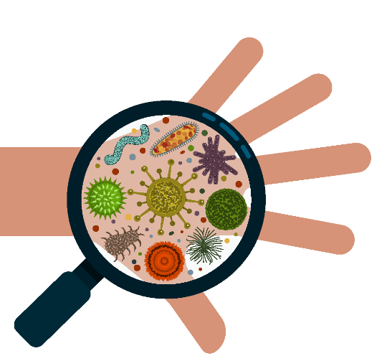


Investigating Immunity
Your name
Follow us
@britsocimm @[your handle]
#CelebrateVaccines
Learn more
immunology.org
[insert your web link here]
Notes:
Introduce yourself and your job in simple terms. Explain that you are a member of the British Society for Immunology. Introduce yourself and your job in simple terms. Explain that you are a member of the British Society for Immunology.
Ask the class:
Has anyone heard the word immune or immunity before? (Hands up)
Where have you heard the word?
Does anyone know what it means? (Take suggestions - if students are struggling, ask if they have heard of the ‘immune system’)

Slide 2
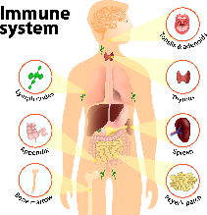
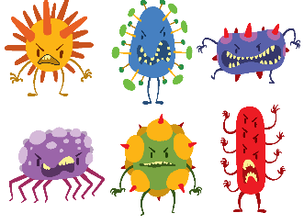
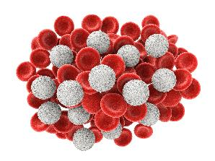

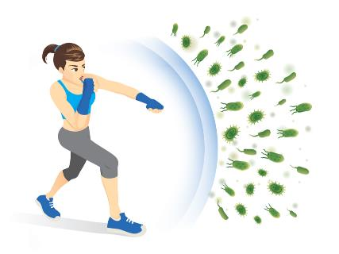
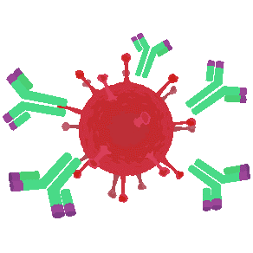
immune
system
pathogens
viruses, bacteria, parasites
white
blood cells
antibodies
immunity
Notes:
Give a simple explanation of immunity using the words and pictures on the slide. Ask the class to repeat the vocab on the slide. Explain that today they are going to do some activities to investigate further how immunity works.
Immune system is the name for all the different things in our bodies that work together to help protect us against illnesses caused by tiny germs called pathogens.
Pathogens viruses, bacteria, or parasites are so small we can’t see them with the naked eye. Today we are mostly going to be thinking about viruses. When a virus enters our body, our immune system works to fight it in lots of different ways, stopping us from getting ill and helping us to get better.
One of the main ways our immune system fights the virus is by making something called antibodies. Antibodies attack the virus. When a new virus enters our body and we get sick, our body must learn which type of antibody to make to fight it.
But the immune system is very smart. If the same kind of virus enters our body again our body can normally remember the right antibody to fight it. So, we are protected from getting sick. This is called immunity. When we are immune to an illness it means we can’t get ill from that type of pathogen anymore.
Explain that today they are going to do some activities to investigate further how immunity works.

Slide 3
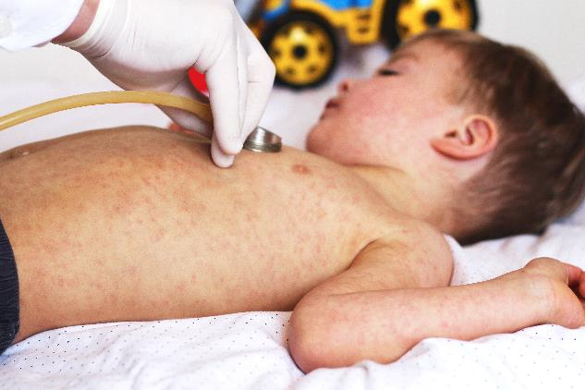
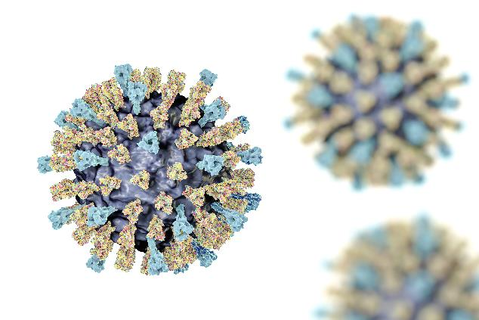
Measles
a highly contagious infectious disease caused by the measles virus
Notes:
Let’s start with an example. Ask the class:
Does anyone know someone who has had measles? (Hands up)
What do you know about measles? Measles is a virus.
Has anyone ever heard that you can’t catch measles twice? Well that’s not 100% true, but it is extremely rare.
Why do you think it’s so rare for someone to get measles twice? (Take suggestions - explain that when someone has measles, their body learns to fight the virus)
Can anyone remember, how does their body fight the virus? (By producing antibodies)
Explain that if they are exposed to the virus again, their body already knows how to make the right antibody to fight it, so the virus is normally defeated before the person experiences any symptoms - they are immune to measles.

Slide 4
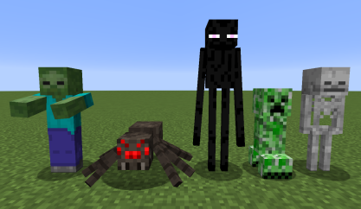
Notes:
Each time you have a virus your body has to learn to fight that particular virus. Like in a video game - sometimes you need to use a different weapon or learn a different technique for fighting a different enemy. Ask the class:
Who has played Minecraft? (Hands up)
Do you kill all the monsters the same way?
What happens if you attack a skeleton underwater in Minecraft?
(It can’t sink so it cannot fight back)
What happens if you try the same technique on a spider?
(Nothing, spiders don’t drown in Minecraft).
What would you do if you were attacked by a new monster you had never seen before? (Prompt for - try all the weapons and fighting techniques you know until you learn how to defeat them. Because it takes time to figure that out, your character will probably take more damage fighting them the first time, but the next time you will be able to defeat them faster).
Well, immunity works in a similar way - just because your body knows how to make the right antibodies to fight measles, it doesn’t mean it knows how to fight other viruses. When you get infected with a new virus, your body has to try different antibodies until it finds the right one.

Slide 5





PERSON 1: VIRUS
PERSON 2: IMMUNE SYSTEM
Choose a piece of the jigsaw and add a sticker. This is the virus
Search through the remaining jigsaw pieces to find one that fits the virus! This is the antibody
Draw around the virus and cut out as many virus pieces as you can! Put them in the bowl
Notes:
Explain that now they are going to investigate how immunity works by playing a game. The aim of the game is to see how long it takes for the immune system to defeat the virus. (10 mins)
For this game you will be working in groups of 3. Each group will have a blank jigsaw.
In your group one person will be the virus. The person who is the virus will choose a piece of the jigsaw. This represents a single virus particle. They will put a sticker on it so they can remember which one it is.
Throughout the game (10 minutes) they will draw around the virus jigsaw piece and cut out as many copies as they can in the time. This represents the virus reproducing. They will put the viruses (jigsaw pieces that they cut out) in the bowl. The bowl represents the body.
The other two people in the group are the immune system. They will need to find the right antibodies to fight the virus - i.e. find a jigsaw piece that fits with the virus jigsaw piece.
If you are the immune system you need to search through the remaining jigsaw pieces to find one that fits with the virus piece.
Once you have found a piece that fits, put a sticker on it so you remember which one it is. This piece represents the antibody that can fight the virus.
You then need to draw around the antibody jigsaw piece and cut out copies to fight the virus pieces.
Each antibody piece can fight one virus piece - once a virus piece has been matched with an antibody, take it out of the bowl.
Ask the teacher to split the class into groups of 3 (if the class does not divide exactly students can work in pairs or fours), and for the groups to sit at desks.

Slide 6


scissors
jigsaw
card
stickers
bowl
Notes:
Give each pair:
1 sheet of stickers
1 jigsaw
1 bowl
4 pieces of card
Scissors
During the game walk around and support any groups that are unsure of what they are doing. Stop the game after 10 minutes or when most groups are getting to the stage where the immune system is defeating the virus.

Slide 7
Reflect
What happened?
Did the immune system get rid of the virus?
What happened once the immune system discovered the right antibody for the virus?
What do you think would happen if the body had the same virus another time?
Notes:
If possible, bring the class back to the carpet area for reflection so that they do not fiddle with the materials. Ask the class:
What happened?
Did the immune system get rid of the virus?
What happened once the immune system discovered the right antibody for the virus?
What do you think would happen if the body had the same virus another time? (Take suggestions) Shall we find out?

Slide 8
PERSON 1: VIRUS
PERSON 2: IMMUNE SYSTEM
Notes:
Explain that they are going to play round 2 of the game to find out what happens if the body gets the same virus again. Ask the students to go back to their desks in the same groups (with the same roles), and repeat the activity - using the same virus and antibody pieces (that should still have the stickers identifying them from round 1), because the immune system remembers the virus and remembers which antibodies can fight it.
In this round the immune system should defeat the virus more quickly, as groups will have 2 students cutting out ‘antibody’ pieces and just 1 cutting out ‘virus’ pieces, and in this round the virus does not have a head start.

Slide 9
Reflect
What happened?
How was the game different this time? Why?
Did the immune system get rid of the virus?
If this was a real person, what would the difference be between the impact of the virus the first time and the second time?
Notes:
If possible, bring the class back to the carpet area for reflection so that they do not fiddle with the materials. Ask the class:
What happened?
How was the game different this time? Why?
Did the immune system get rid of the virus?
If this was a real person, what would the difference be between the impact of the virus the first time and the second time? (Prompt for - the virus would be defeated before the person got ill)

Slide 10
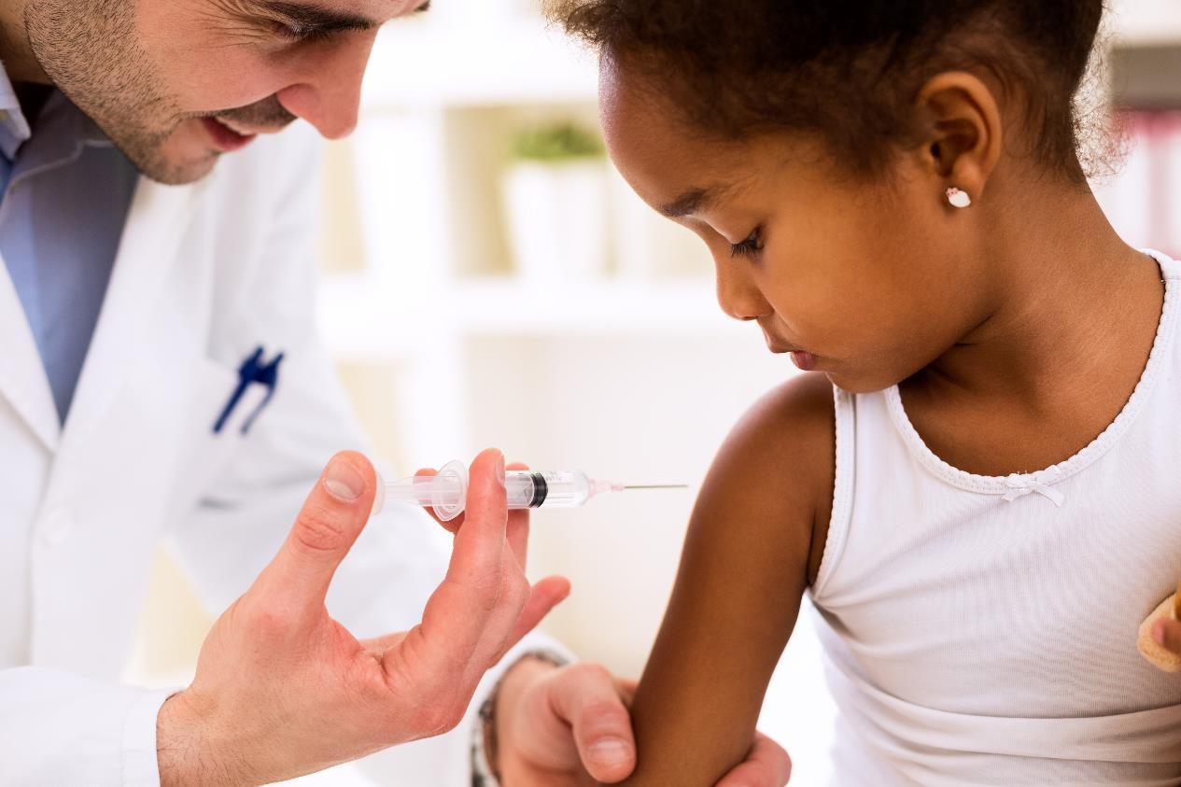
Notes:
Ask the class:
Has anyone heard the word vaccine before? (Hands up)
Where have you heard the word?
Does anyone know what a vaccine is?
Have you had any vaccinations? (Hands up)
Explain that when we get a virus and our body learns how to make antibodies to fight it, we call this immunity. Scientists have developed vaccines that imitate this process. Vaccines put weak or dead versions of the virus into our bodies so that our immune system can learn which antibodies to make to fight the virus, without us getting sick (or only getting a little bit sick).

Slide 11
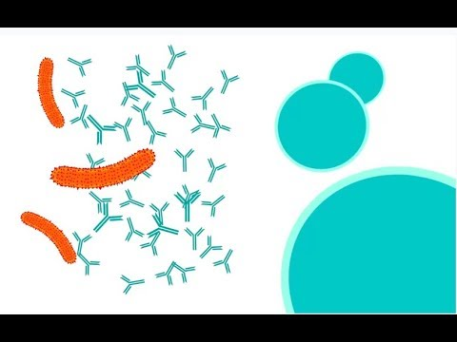

How do vaccines work?

Slide 12
PERSON 1: VIRUS
PERSON 2: IMMUNE SYSTEM
Antibody
Weak or dead virus particle
Notes:
Explain that they are going to play one last round of the game, to find out what happens when we get a vaccination.
This time the virus does not reproduce, so all the students will play the role of the immune system.
One person will administer the vaccine. They will choose a new jigsaw piece and put a sticker on it. This represents the weak or deadened virus particle contained in a vaccine. They will put this in the bowl.
The students then play the role of the immune system. As in the first round, they have to find the matching jigsaw piece - this represents the right antibody to fight the virus.
Once they find it they should put a sticker on it (to show the immune system ‘remembering’ which antibody to make to fight the virus) and take the piece representing the dead or weakened virus out of the bowl.
Ask the students to go back to their desks and play the third round of the game. Stop the game after 5 minutes or when the groups finish the game.

Slide 13
Reflect
What happened?
How was the game different this time? Why?
Did the immune system get rid of the virus?
What do you think would happen if this person got infected with the virus again? Why?
Notes:
If possible, bring the class back to the carpet area for reflection so that they do not fiddle with the materials. Ask the class:
What happened?
How was the game different this time? Why?
Did the immune system get rid of the virus?
What do you think would happen if this person got infected with the virus again? Why? (Prompt for explanation using the vocab students have learnt today - the person would be immune; their immune system would already know which type of antibody to make to fight the virus and would be able to fight it before the person got sick).
Go back to desks and tidy up materials from the game.

Slide 14
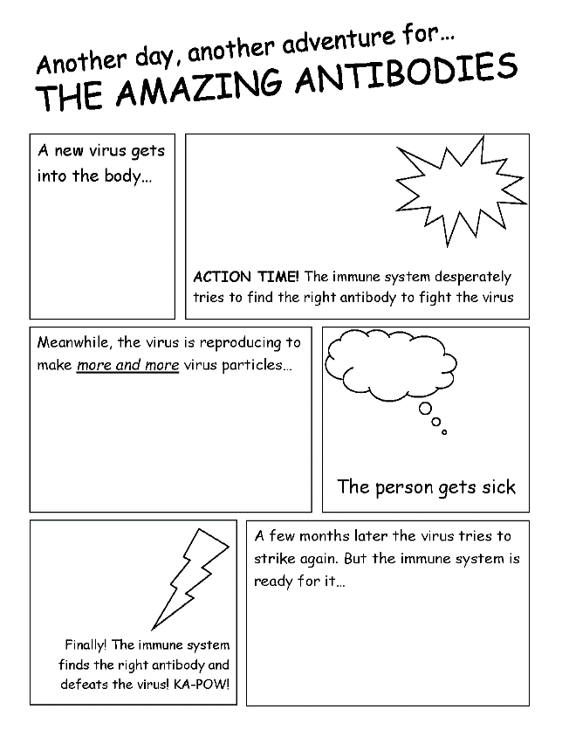

Slide 15

Quiz!
    Can you name three kinds of germs?
    Bacteria, viruses, parasites
    What does a vaccine contain?
    Dead or weakened virus particles
    What type of germ does a vaccine protect you against?
    Most vaccines protect us from viral infections (viruses), some protect us from bacterial infections
    What is it called when your body already knows how to fight a virus?
    Immunity
    What does your body produce to fight viruses?
    Antibodies
Notes:
Recap vocabulary and learning using the quiz questions on the slides. Click to reveal question, then answer. Click again for next question. There are five questions in total.

