Slide 1
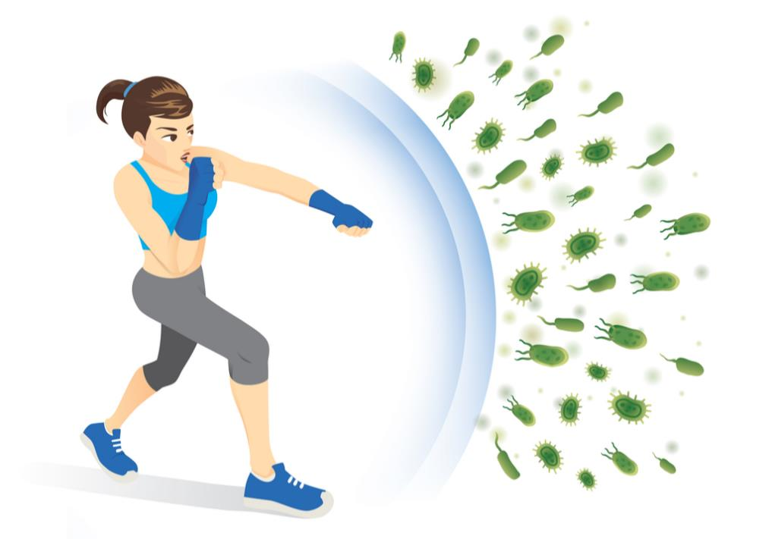
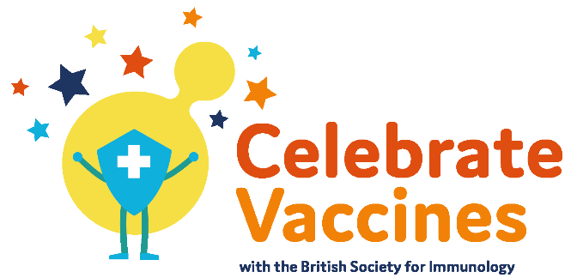
the Immune System and Vaccination
your name
Follow us @britsocimm @[your_handle] #CelebrateVaccines
Learn more immunology.org [Insert your web link here]

Slide 2
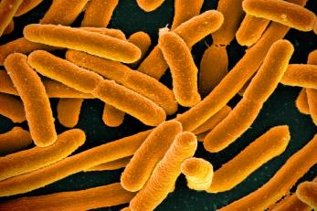
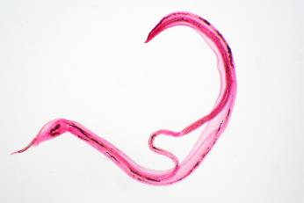
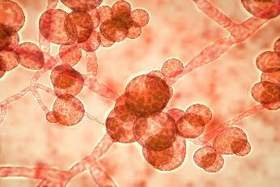
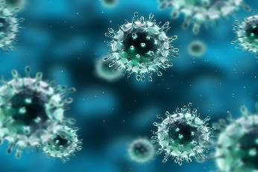
The human body faces things that can make it sick everyday. These things are called pathogens.
Bacteria
Parasites
Fungus
Viruses
Notes:
Ask for suggestions about what the pathogens shown are. Click to reveal the names of the pathogens.

Slide 3
But your immune system helps to protect you
Bacteria
Parasites
Fungus
Viruses
Notes:
Although there are pathogens all around us, we don’t get sick because of the immune system.

Slide 4
Immune system Organs, Tissues, Cells
It can
Identify a threat
Mount an attack
Eliminate the pathogen
Remember the pathogen for future protection
But, sometimes it goes wrong
Allergies
Asthma
Arthritis
Notes:
Talk through text on slide. Elaborate on organs/tissues/cells for older students. Click to reveal what the immune system can do. Click again to reveal examples of when immunity can go wrong.

Slide 5
Immune system
Innate Immune Response
Adaptive Immune Response
Notes:
The immune system is split into two aspects, innate and adaptive

Slide 6
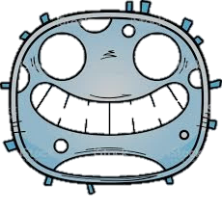
Immune system
Innate Immune Response
Adaptive Immune Response
Non-specific
Distinguishes between human cells and pathogens
But not between different types of pathogen
Fast
But no memory
Highly specific
Distinguishes between different pathogens based on shapes on the surface – called antigens
Can take weeks
But cells remember
Notes:
Describe innate immune system. It is non-specific – meaning it can distinguish between human (‘self’= blue cell) and pathogen (‘non-self’=red cell) but not between different pathogens.

Slide 7
Immune system
Innate Immune Response
Adaptive Immune Response
Non-specific
Distinguishes between human cells and pathogens
But not between different types of pathogen
Fast
But no memory
Highly specific
Distinguishes between different pathogens based on shapes on the surface – called antigens
Can take weeks
But cells remember
?
?
?
?
?
Notes:
The innate immune response is fast but the body doesn’t remember the pathogen or how to fight it

Slide 8
Immune system
Innate Immune Response
Adaptive Immune Response
Non-specific
Distinguishes between human cells and pathogens
But not between different types of pathogen
Fast
But no memory
Highly specific
Distinguishes between different pathogens based on shapes on the surface – called antigens
Can take weeks
But cells remember
antigens
Notes:
Describe adaptive immune system. It is specific – meaning it can distinguish between different pathogens based on shapes on their surface (called antigens). The response is slower, but the body remembers how to fight specific pathogens

Slide 9
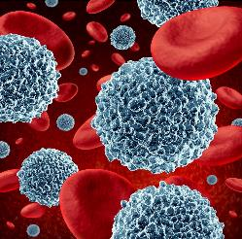
How does the immune system fight?
White blood cells
Innate Immune Response
Adaptive Immune Response
Notes:
Ask – does anyone know how the immune systems fights pathogens? Click to reveal answer – white blood cells

Slide 10
How does the immune system fight?
White blood cells
Innate Immune Response
Adaptive Immune Response
Myeloid cells
(Identifies My cells from not My cells)
Swallows the pathogen whole to kill it and shows antigens
Called Phagocytosis
Notes:
Describe the innate immune response in terms of myeloid cells ‘swallowing’ pathogens

Slide 11
How does the immune system fight?
White blood cells
Innate Immune Response
Adaptive Immune Response
Myeloid cells
(Identifies My cells from not My cells)
Lymphoid cells
Swallows the pathogen whole to kill it and shows antigens
antigen
Notes:
Describe how the myeloid cells show antigens to lymphoid cells of the adaptive immune system

Slide 12
How does the immune system fight?
White blood cells
Innate Immune Response
Adaptive Immune Response
Myeloid cells
(Identifies My cells from not My cells)
Lymphoid cells
Makes specific antibodies which fit onto specific pathogen antigens
Swallows the pathogen whole to kill it and shows antigens
and signal for destruction
Notes:
The lymphoid cells then make specific antibodies to fit the shapes of antigens. Click to reveal that this signals the body for destruction.

Slide 13
How does the immune system fight?
White blood cells
Innate Immune Response
Adaptive Immune Response
Myeloid cells
(Identifies My cells from not My cells)
Lymphoid cells
Makes specific antibodies which fit onto specific pathogen antigens
Swallows the pathogen whole to kill it and shows antigens
Some form memory cells to protect you in the future
Notes:
Some cells form memory cells for future protection

Slide 14
100 healthy people
Notes:
You have a healthy population

Slide 15
Pathogens can be
Bacteria
Fungi
Parasites
Viruses
1
Examples?
Notes:
But one person gets sick (green face) with a pathogen. Ask for suggestions of specific pathogens.

Slide 16
Pathogens can be
Bacteria
Fungi
Parasites
Viruses
1
Examples?
E.Coli
Athlete’s foot
Malaria
Flu (influenza)
Notes:
Here are some pathogens to mention in case the students don’t have an answer

Slide 17
Pathogens can passed on to the people around you
1
Notes:
When you are sick you can spread the pathogen to the people around you as shown by the box and arrows

Slide 18
Pathogens can passed on to the people around you
2
3
1
4
5
A coin was tossed to see if a person was infected or not
Person | Number of new infections
1 | 4
Notes:
A coin was tossed to see if a connected healthy person was infected or not (50% chance of infection). Infected person 1 infected 4 new people (green faces 2-5)

Slide 19
6
7
Pathogens can passed on to the people around you
8
2
3
1
9
4
5
A coin was tossed to see if a person was infected or not
Person | Number of new infections
1 | 4
2 | 4
Notes:
This was repeated for infected person 2, who infected 4 new people (light green faces 6-9)

Slide 20
6
7
Pathogens can passed on to the people around you
8
2
10
3
1
9
11
4
12
5
A coin was tossed to see if a person was infected or not
Person | Number of new infections
1 | 4
2 | 4
3 | 3
Notes:
This was repeated for infected person 3, who infected 3 new people.

Slide 21
20
6
7
18
42
54
66
67
Pathogens can passed on to the people around you
24
25
8
2
19
31
43
44
56
80
10
3
1
21
9
22
32
55
57
68
11
4
12
5
14
23
45
58
69
81
Until there are no new infections
13
27
15
16
17
30
33
59
70
77
26
34
28
29
37
40
41
51
64
35
46
36
38
39
49
52
53
65
78
47
58
48
50
75
63
85
79
84
60
61
62
76
82
86
89
87
71
73
72
74
83
88
90
91
Notes:
This process can go on until there are no new infections. Highlight that some people were not infected.

Slide 22
20
6
18
42
54
66
67
Pathogens can be deadly
24
25
2
19
31
43
44
56
80
10
3
1
21
9
22
32
55
68
45
Typhoid 10% mortality
11
4
12
5
14
23
58
69
81
27
15
16
30
33
59
70
77
26
34
28
29
37
40
41
51
64
35
46
36
38
39
52
53
65
78
47
58
50
75
63
79
84
60
61
62
76
82
86
89
87
71
72
74
83
88
90
91
Notes:
Pathogens can kill. Typhoid mortality is 10% and shown as missing faces.

Slide 23
6
Pathogens can be deadly
24
Ebola can have up to 90% mortality
58
15
51
35
79
60
86
Notes:
Ebola death rate can be up to 90%

Slide 24
66
Some pathogens can make you sick for a long time
1
22
But most people recover and are now protected by antibodies in their immune system
59
35
76
Notes:
While some pathogens make you sick and infectious for a long time, most people recover and are protected by antibodies from their immune system.

Slide 25
Vaccines protect us from pathogens
1
Examples?
BCG
Whooping cough
MMR
Polio
Notes:
Vaccines are used to protect us from pathogens. Ask for examples they might know of or have had. Click to reveal some vaccine examples.

Slide 26
Vaccines protect us from pathogens
1
Expose the immune system to pathogens in a safe way - without catching the disease
Notes:
Vaccines expose the immune system to pathogens safely and without having to catch the disease first

Slide 27
How does it work?
The 3 types of vaccines contain
A weakened pathogen
(not strong enough to make us sick)
A killed pathogen
(can’t make us sick)
A small part of a pathogen
(like an antigen)
live-attenuated vaccine
inactivated vaccine
subunit vaccine
All vaccines contain antigens which trigger the immune system to create specific antibodies
X X
A signal for pathogen destruction in future
Notes:
Describe the 3 types of vaccine in terms of what they contain, then name them. Click to discuss that vaccines contain antigens (red arrows) which trigger the immune system to create antibodies

Slide 28
Vaccines
Benefits
Provide protection from pathogens which can kill or make you sick
Control and eradication of once common pathogens like polio and smallpox
Stops outbreaks and global epidemics
Risks/challenges
No medicine is 100% effective – people can sometimes still catch the pathogen but this is very rare
Side effects like swelling and fevers
Not all pathogens have a vaccine for example malaria parasites
Notes:
List the benefits of vaccines and ask what type of pathogen polio and smallpox are (viruses). Ask if anyone knows what ‘Eradication’ means. Then, discuss the risks. Vaccines produce immunity in 85% to 95% of people. If you are very unlucky and still catch the disease, the symptoms are often milder.

Slide 29
Vaccines
Benefits
Provide protection from pathogens which can kill or make you sick
Control and eradication of once common pathogens like polio and smallpox
Stops outbreaks and global epidemics
Risks/challenges
No medicine is 100% effective – people can sometimes still catch the pathogen but this is very rare
Side effects like swelling and fevers
Not all pathogens have a vaccine for example malaria parasites
The benefits outweigh the risks so vaccines are given to people
Scientists work to make and improve vaccines
Notes:
Make it clear that the benefits (in saving lives) outweigh the risks and that there is on-going research into new vaccines. Maybe bring up your own research if applicable.

Slide 30
Some people can’t be vaccinated
1
Young babies
Very old people
People with certain diseases
People with certain allergies
Pregnant woman
People with damaged immune systems
Notes:
Some people like very young babies, the very old, people with certain diseases or allergies, pregnant women, and people with damaged immune systems can’t be vaccinated

Slide 31
Some people can’t be vaccinated
1
But can still be protected due to herd immunity
Notes:
The really clever bit is that these people are still protected because they are surrounded by people that can’t catch the disease. This is known as herd immunity.

Slide 32
How many people need to be vaccinated to stop the pathogen spreading?
1
95%?
Notes:
But how many people (that can be vaccinated) need to be vaccinated to stop a pathogen spreading and generate herd immunity? 95%?

Slide 33
How many people need to be vaccinated to stop the pathogen spreading?
1
95%?
80%?

Slide 34
How many people need to be vaccinated to stop the pathogen spreading?
1
95%?
80%?
50%?

Slide 35
How many people need to be vaccinated to stop the pathogen spreading?
1
Let’s find out!
95%?
80%?
50%?

Slide 36
Pathogen Outbreak Model Example
How many people need to be vaccinated to stop the pathogen spreading?
Pick one of the un-vaccinated people. Label that person 1 and colour them in green
If they are connected to another unvaccinated person – flip a coin or roll a dice so they have a 50% chance of infecting them
Heads or Even numbers = infected
Tails or Odd numbers = uninfected
Infected people are coloured in green and numbered. Write the number new infections in the table
If the newly infected people are connected to an unvaccinated person – repeat steps 2 & 3
Note If an unvaccinated person is connected to more than 1 infected person they risk infection from all connections – you can flip/roll for each new infected connection
1
Person | Number of new infections
1 | 0
Notes:
Leave this slide up while the students are doing the experiments

Slide 37
Pathogens
E.coli
Athlete’s foot
Malaria
Flu (Influenza)
Make you sick and some people can die
Can spread from person to person
Immune system
Helps to protect you from pathogens
Innate immune system is fast but has no memory
Adaptive immune system is slower by remembers
Produces antibodies
Vaccination
Exposes the immune system to pathogens in a safe way
Protects you from pathogens by generating antibodies
Herd immunity protects people that can’t be vaccinated
But the vaccinated population must be high
We modelled pathogen outbreaks with 95%, 80% and 50% vaccinated populations
Notes:
Final summary slide

Slide 38
Follow us @britsocimm @[your_handle] #CelebrateVaccines
Learn more immunology.org [Insert your web link here]
Thank you

